Slide 1
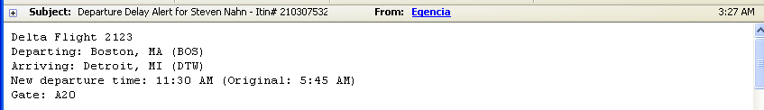
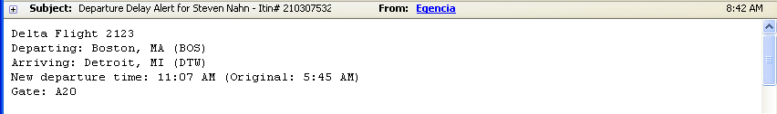
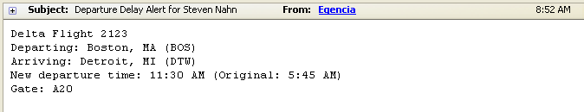
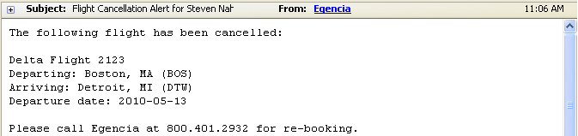

Slide 2
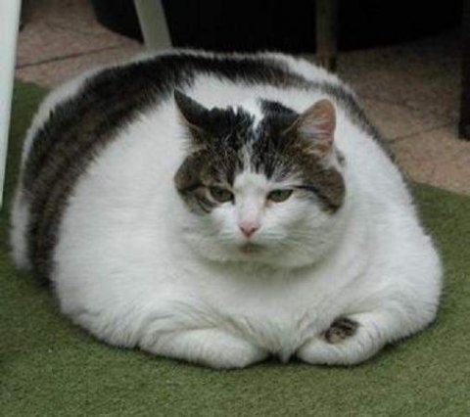


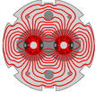
High Mass SM Higgs at the LHC
S. Nahn, MIT
On behalf of ATLAS, CMS,
and CERN Beams Division

Slide 3
Basics

Slide 4
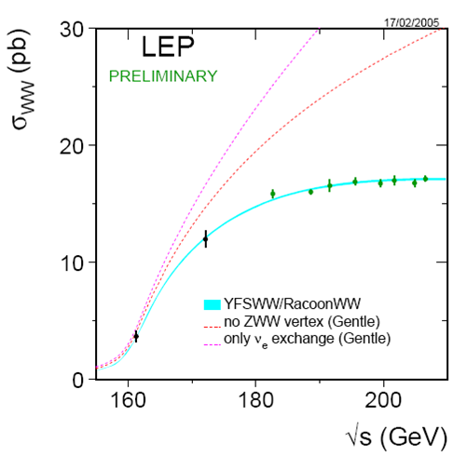
Argument† for “higgs-like” existence
Unitarity
  J=1 amplitudes cancel nicely
  m_{e} ≠ 0 ⇒ J=0 amplitude (“wrong helicity”) break unitarity!
  Need to cancel with scalar coupling to mass
† from an experimentalist. Beware

Slide 5
Higgs Cliff’s Notes
How Made
  Gluon-Gluon fusion
  Vector Boson fusion
    σ_{gg} ∼ σ_{VBF} ×10, but taggable forward jets
  Higgsstrahlung (LEP + Tevatron)
How decays
  Boson Couplings-W,Z
  Fermion Couplings – top!
  H→γγ for low mass

Slide 6
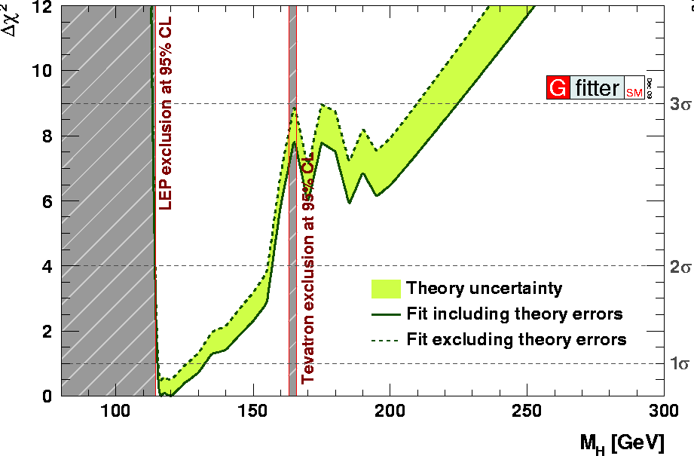
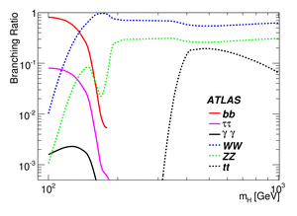
Current State of Affairs
Where it lives
  LEP: m_{H}>114 GeV
  TeV: m_{H}∉[162,166] GeV
  Unitarity m_{H}<1 TeV
  EW fits: m_{H} < ~ 200 GeV
“High” vs “Low” from branching ratio
  m_{H} > 130 GeV
  H→WW,ZZ
  m_{H} < 130 GeV
  H→γγ,ττ
Low
High

Slide 7
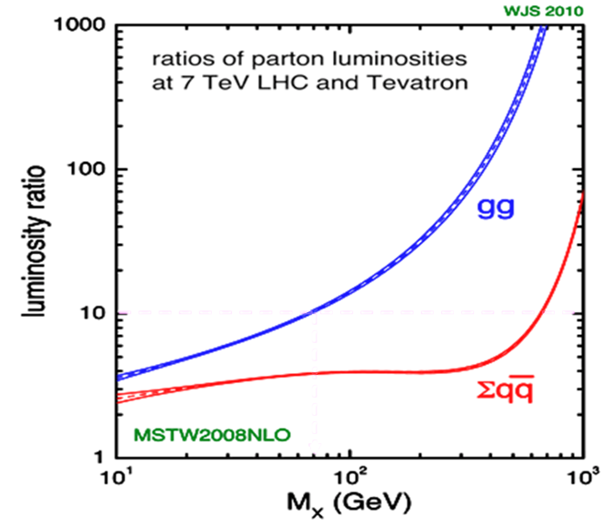
Production @LHC
Anticipated Lumi shrinking
gg Luminosity Bonus
  m_{H} = 150 GeV → ×20
14 ⇒ 7 TeV Penalty
Higher order Windfall
“1st Year” 05
“1st Year” 07
“1st Year” 09

Slide 8
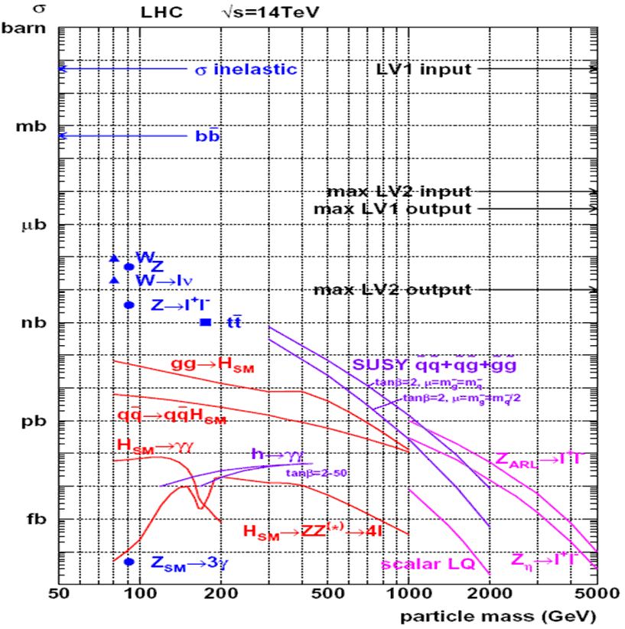
Strategy: High Mass Channels: WW, ZZ
Use leptonic decays to dig through QCD
  high p_{T}, Isolated e,μ
  νs missing E_{T} (MET)
  moderate jet activity
  kinematics
Most interesting
Intriguing
Deferred to later…
Dreaming
Current Reach

Slide 9
Battle against Backgrounds
QCD → two fake leptons, but also jets
  Reconstruct jets, allow none above minimum p_{T} in central region
    VBF: tag forward region
  explicit b tagging: reject soft leptons from Heavy flavor
Single Bosons plus Fake lepton
  W + jets, Z + jets with one jet faking lepton, conversions
    Detailed study of “fake lepton” rates
Standard Model Diboson production (no fakes!)
  WW, ZZ, ZW, tt, tW
    Early Standard Model measurements
    Get irreducible normalization from control regions
      Eg tt: extrapolate from ≥ 2 jet bins
Notes:
Change order = two fakes, one fake, no fakes

Slide 10
A bit on detectors (CMS bias)
ATLAS bias given in talk by Marumi Kado this morning

Slide 11
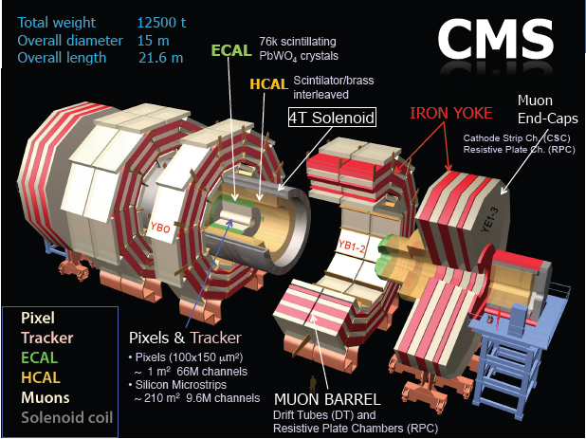
Notes:
What do you want to say about each piece

Slide 12
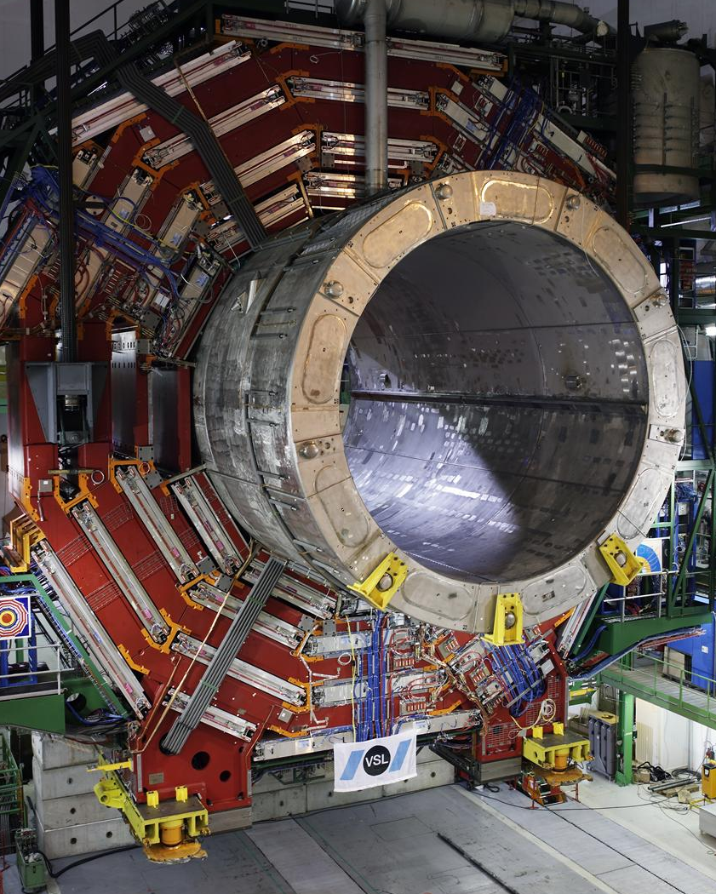
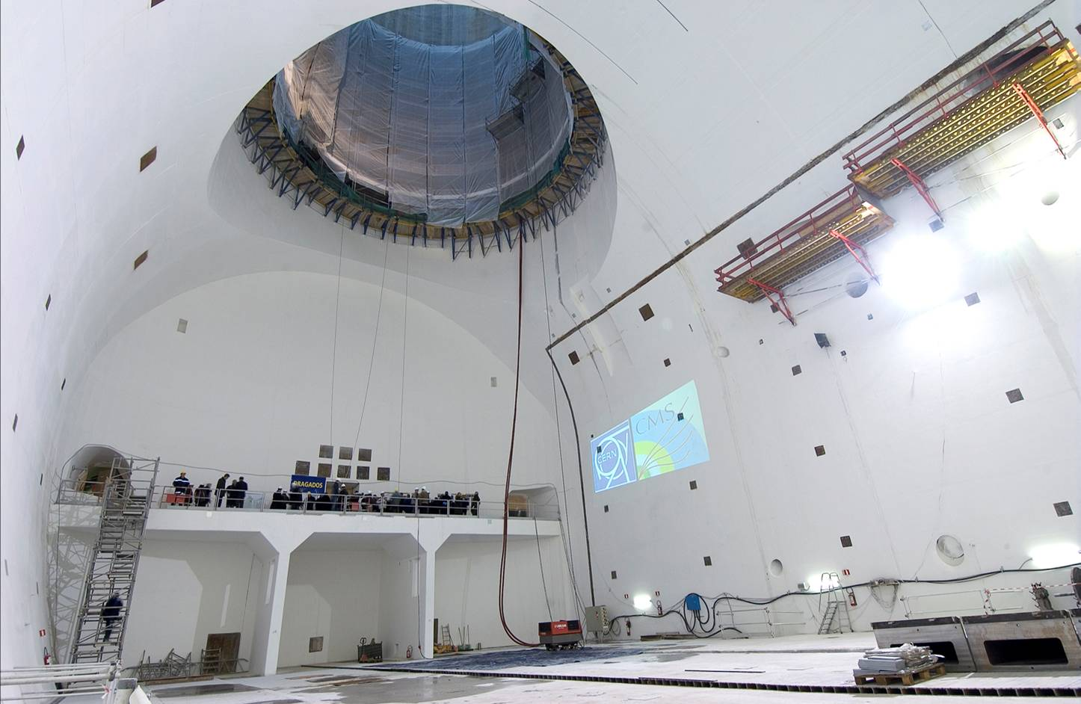
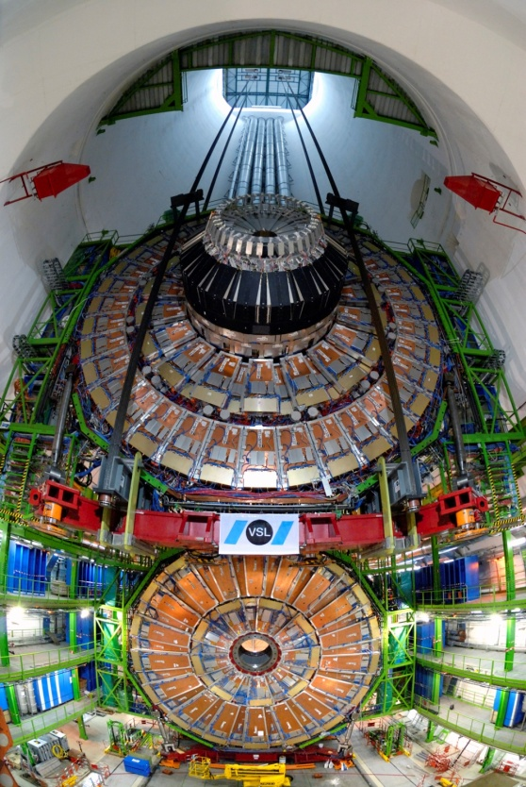
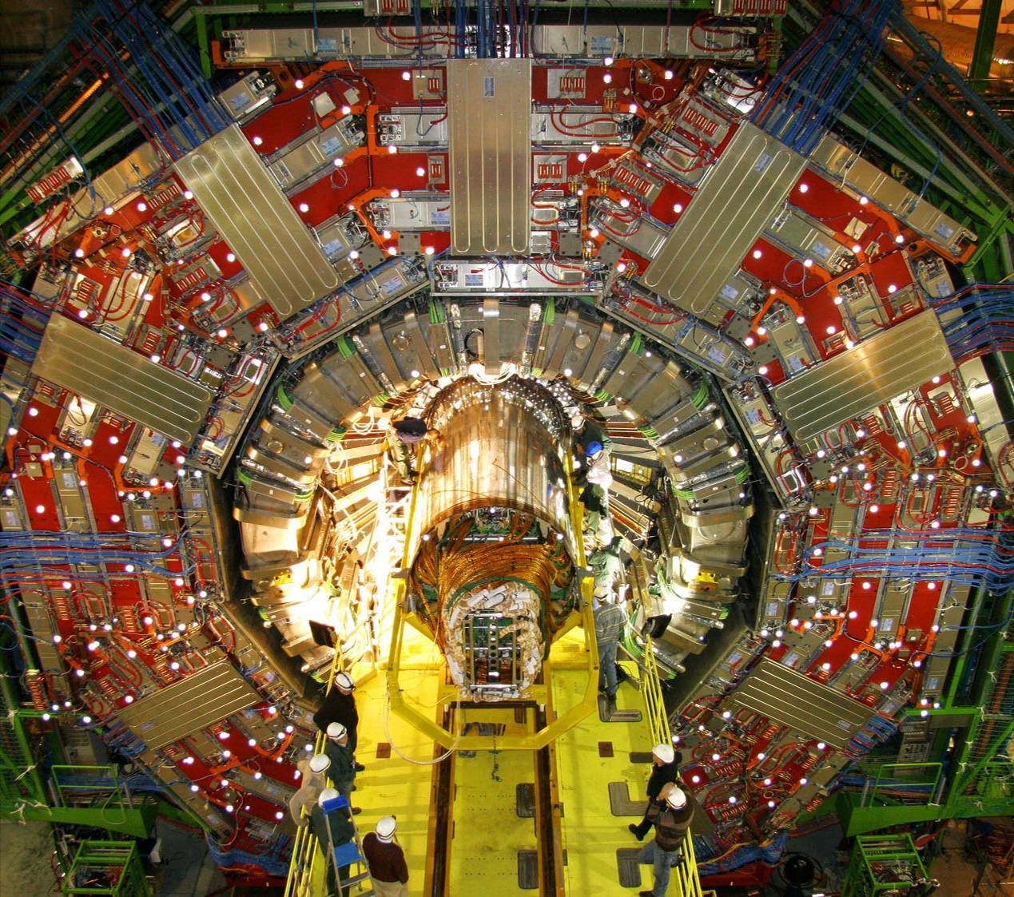
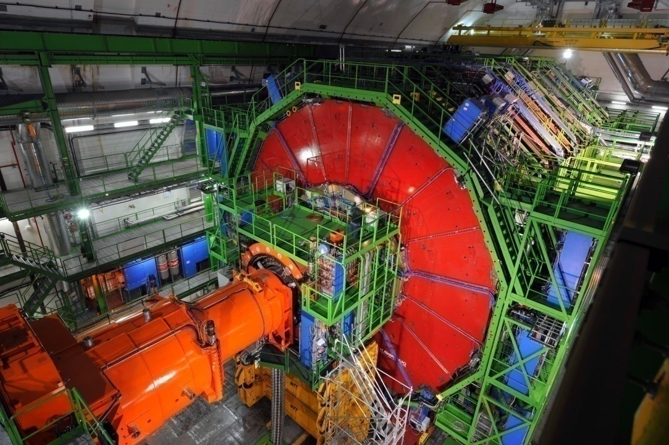
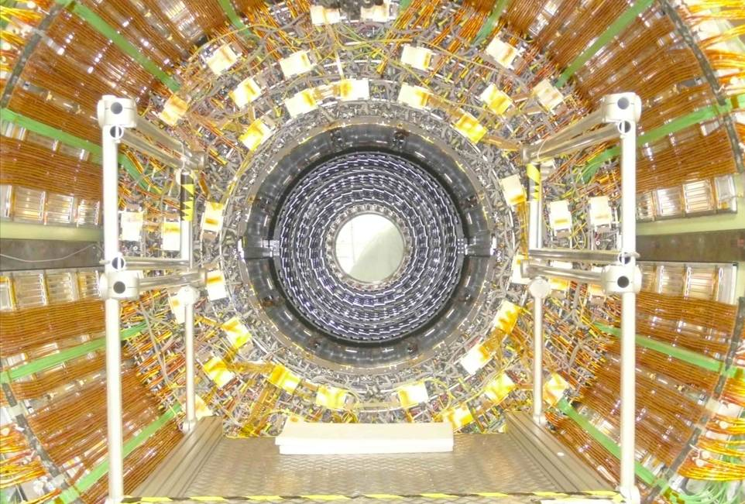
Some assembly required

Slide 13
Vital Statistics
Tracker
  |η| < 2.5
Calorimetry
  ECAL |η| < 3
  HCAL |η| < 5
Muons
  |η| < 2.4
Tracker
  |η| < 2.5
Calorimetry
  ECAL |η| < 3.2
  HCAL |η| < 4.9
Muons
  |η| < 2.7
IMHO, although designs have substantial differences, both have been designed to excel at this particular set of measurements, so performance will be comparable

Slide 14
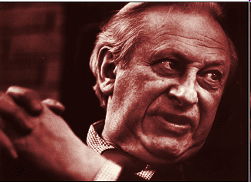
What we think we know
from Simulation…
“An Agnostic is just a cowardly Atheist”
-Studs Terkel, 1931-2008
Handle on detector effects + mis-simulation with:
  Simulation with misaligned, uncalibrated detector
  “Data driven” methods: extract background contamination, efficiencies from data itself

Slide 15
Ingredients to find a heavy higgs

Slide 16
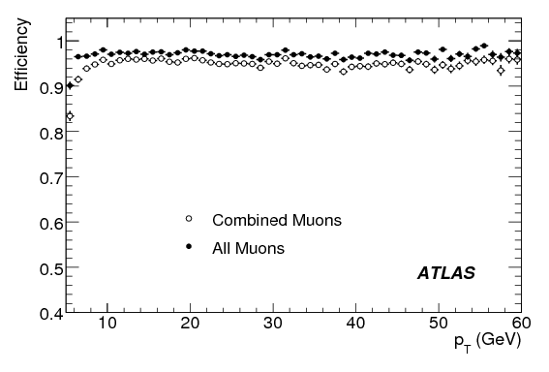
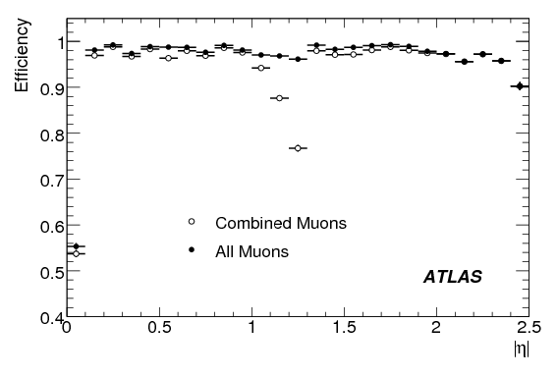
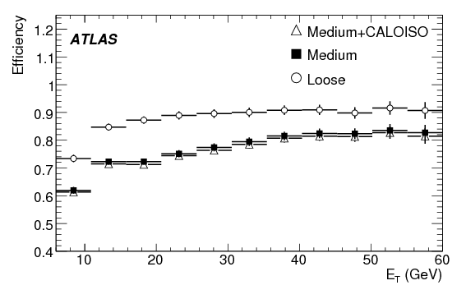
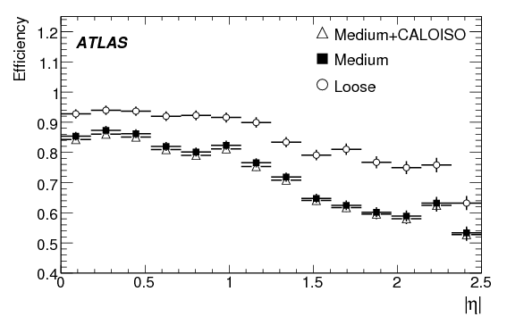
Lepton Selection
p_{T}>15-20 GeV, isolation using tracks + calorimetry
Typical efficiencies μ ~ 95% , e ~ 70-80%

Slide 17
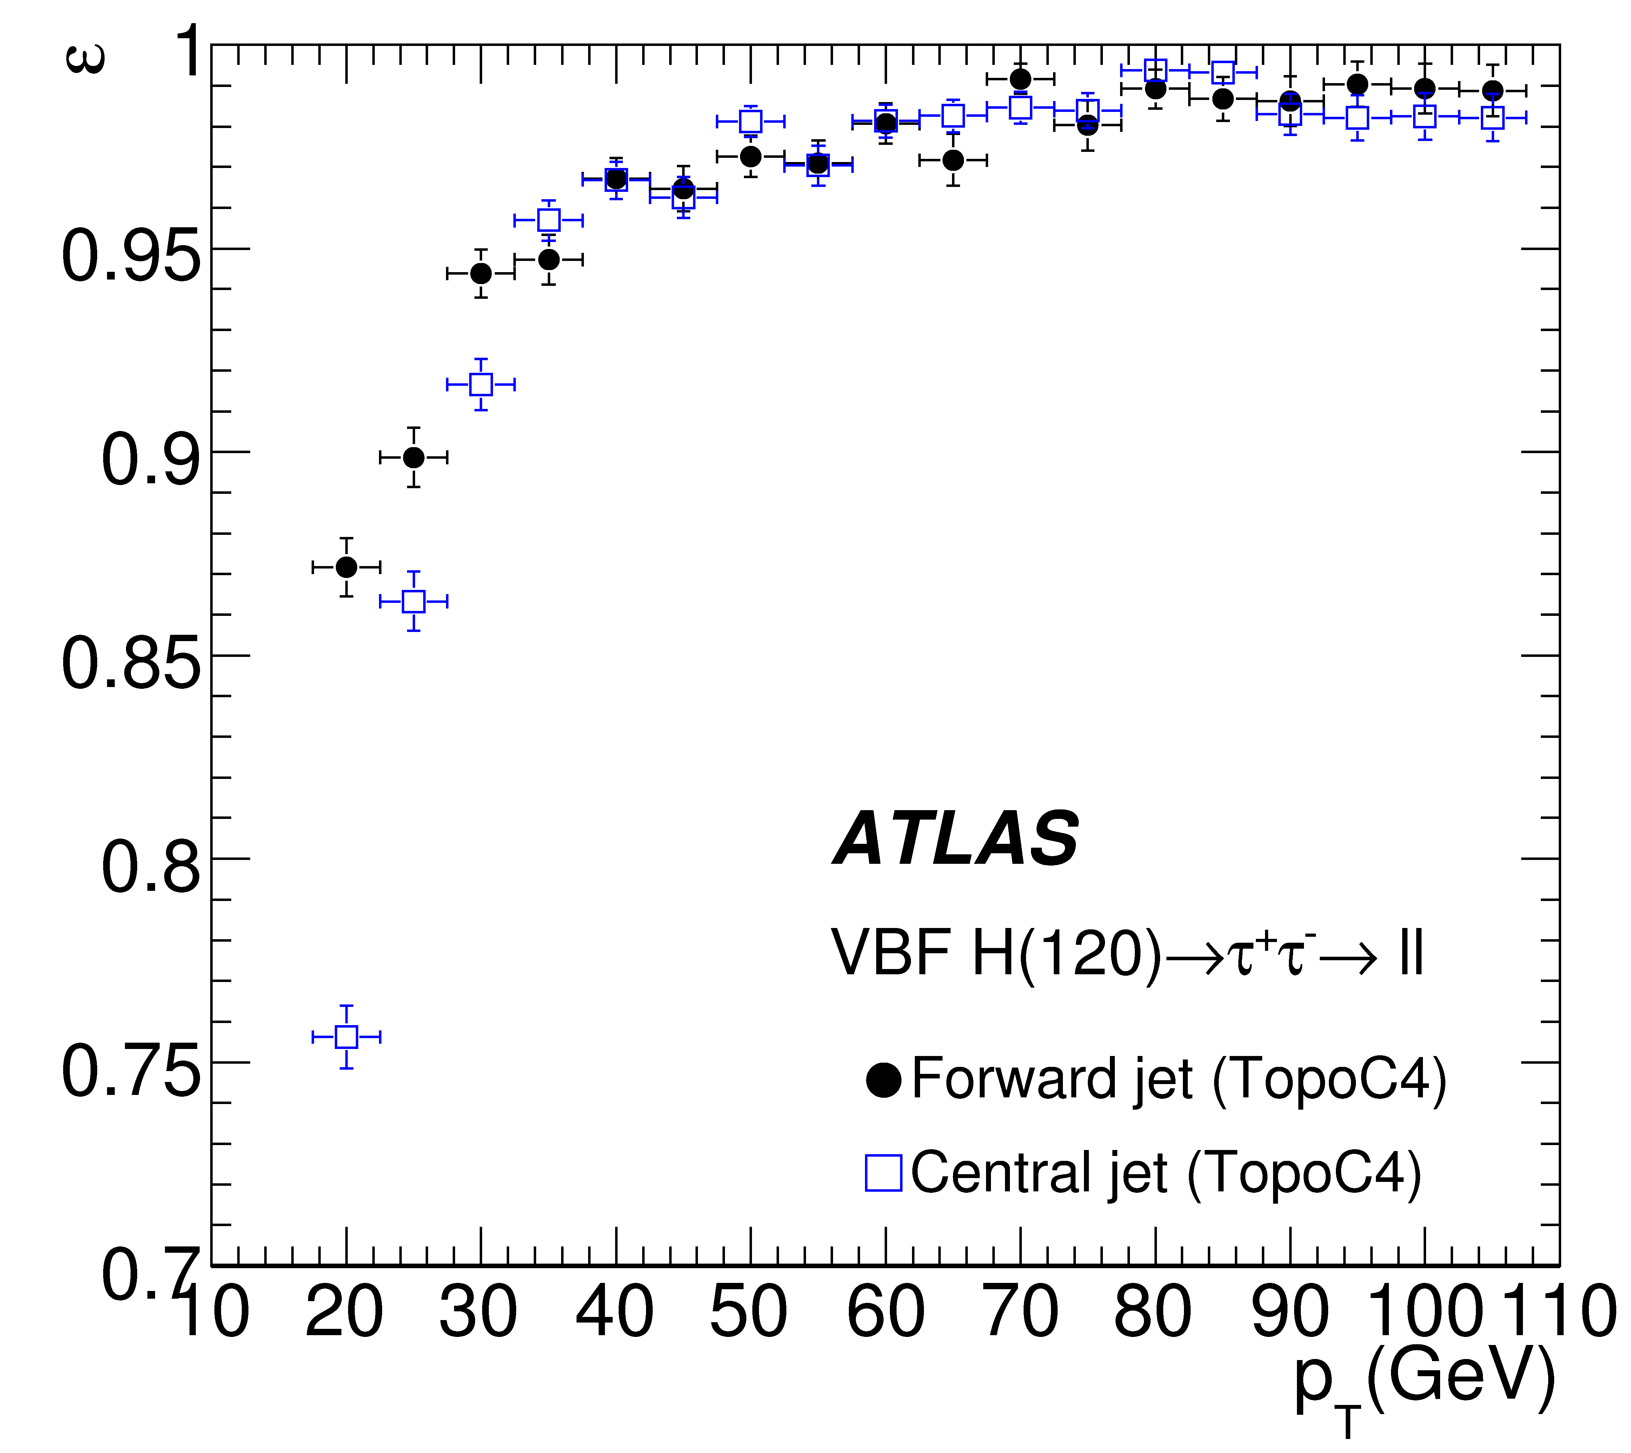
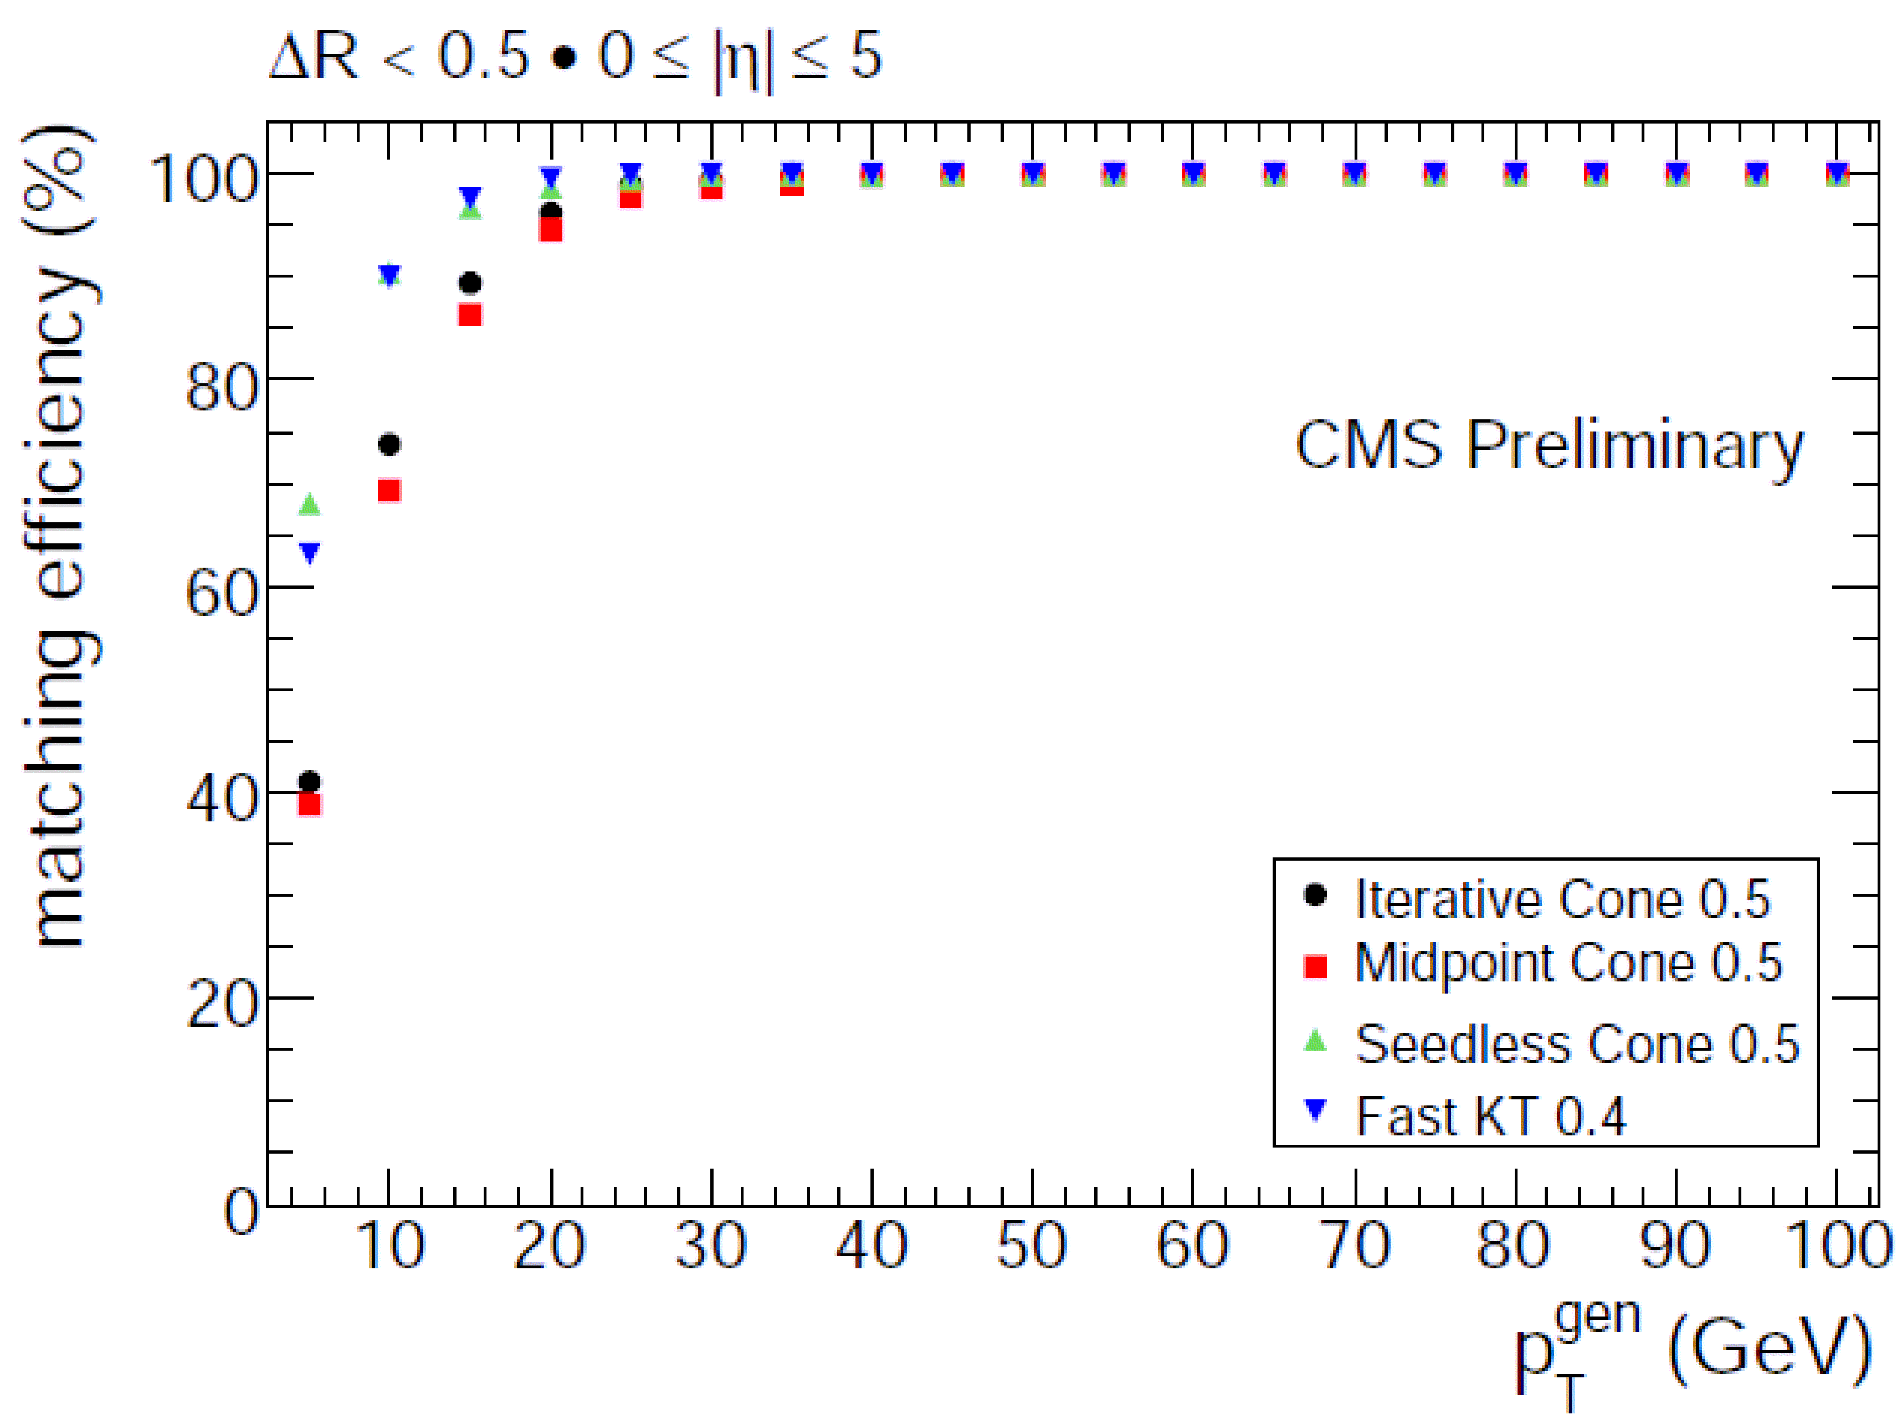
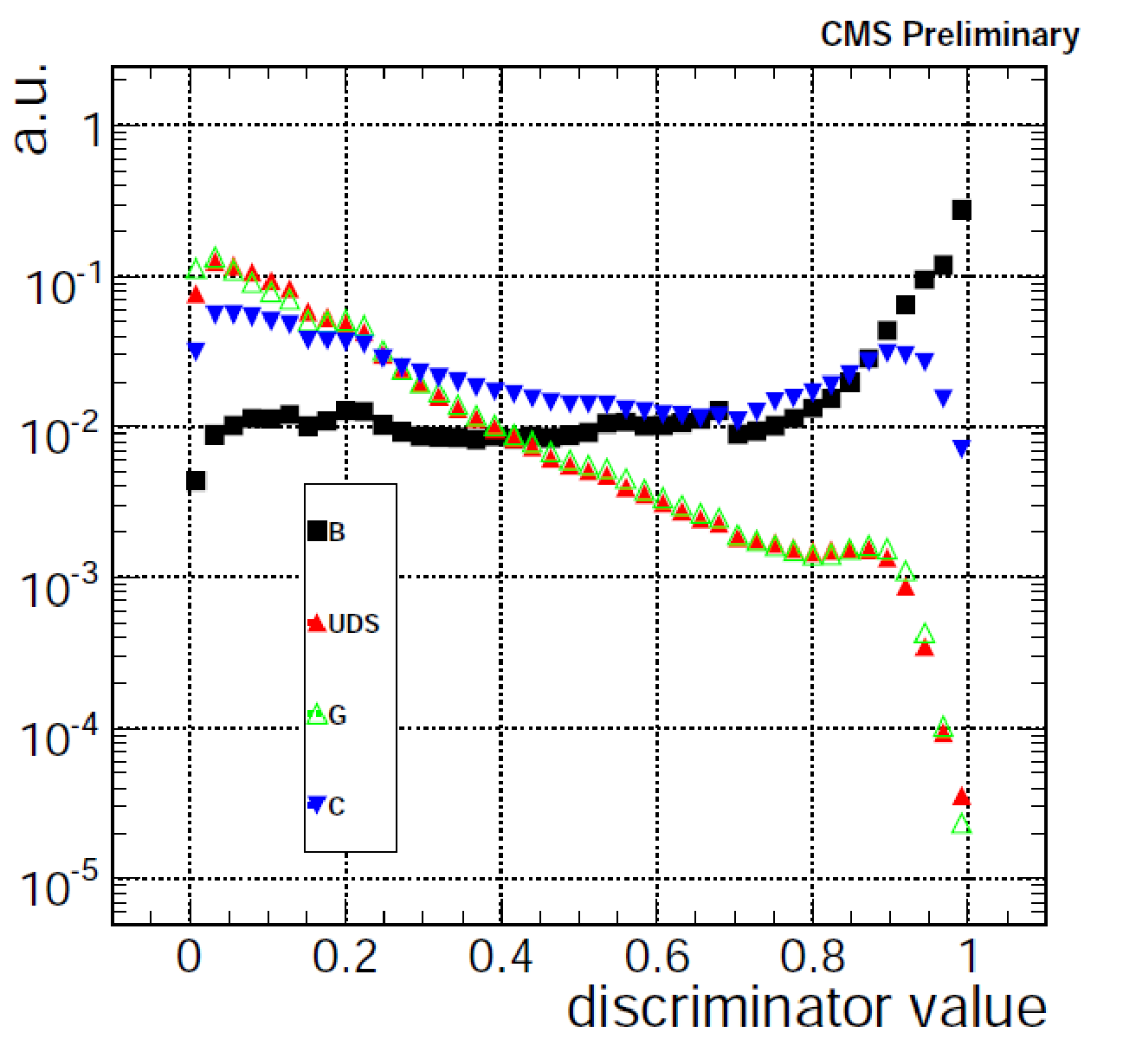
Jet and Heavy Flavor Veto
Count all Jets above 20 GeV
b tagging to remove Heavy flavor leptons
  Soft leptons
  Large impact parameter
  Substantial SV mass

Slide 18
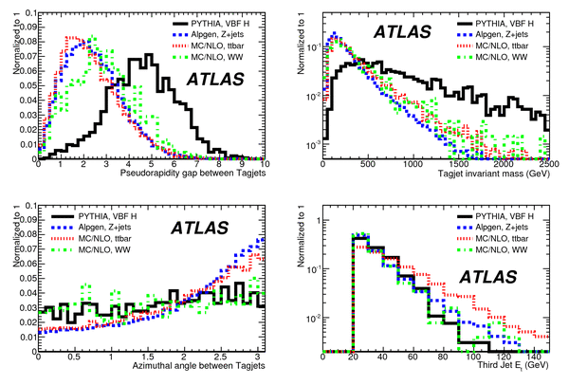
Vector Boson Fusion
Veto central AND accept 2 forward jets in opposite hemi.
  Sensitive to fermiphobic higgs

Slide 19
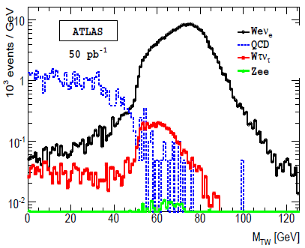
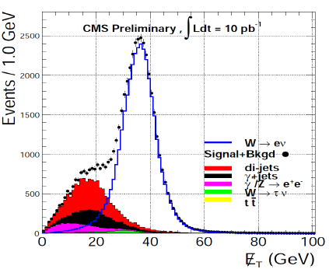
Missing Energy
Use W decays to characterize MET
Leading source of emphasis on extracting resolutions from data…

Slide 20
Engineering numbers from data
Efficiency : use two lepton resonances
  good lepton (“tag”) + unbiased lepton (“probe”)
Lepton Fake rates
  Choose orthogonal fake-rich sample (anti selection) and extrapolate into signal region
Missing Energy
  Use QCD-rich, Z→, γ +jets to measure resolution
  Compare Z→() data with W→ν MC
  Use btagged sample: Clean source of
Background Normalization
  Measure in ≥ 2 jets bin, extrapolate to 1 or 0 jets
  Z, WW extrapolate in m

Slide 21
H→W⁺W⁻→⁺ν'⁻ ν'

Slide 22
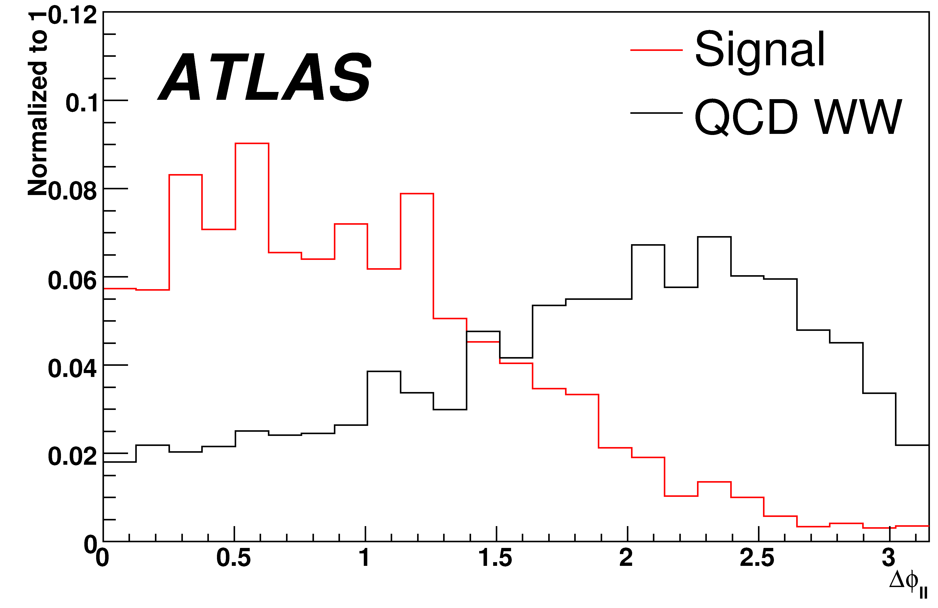
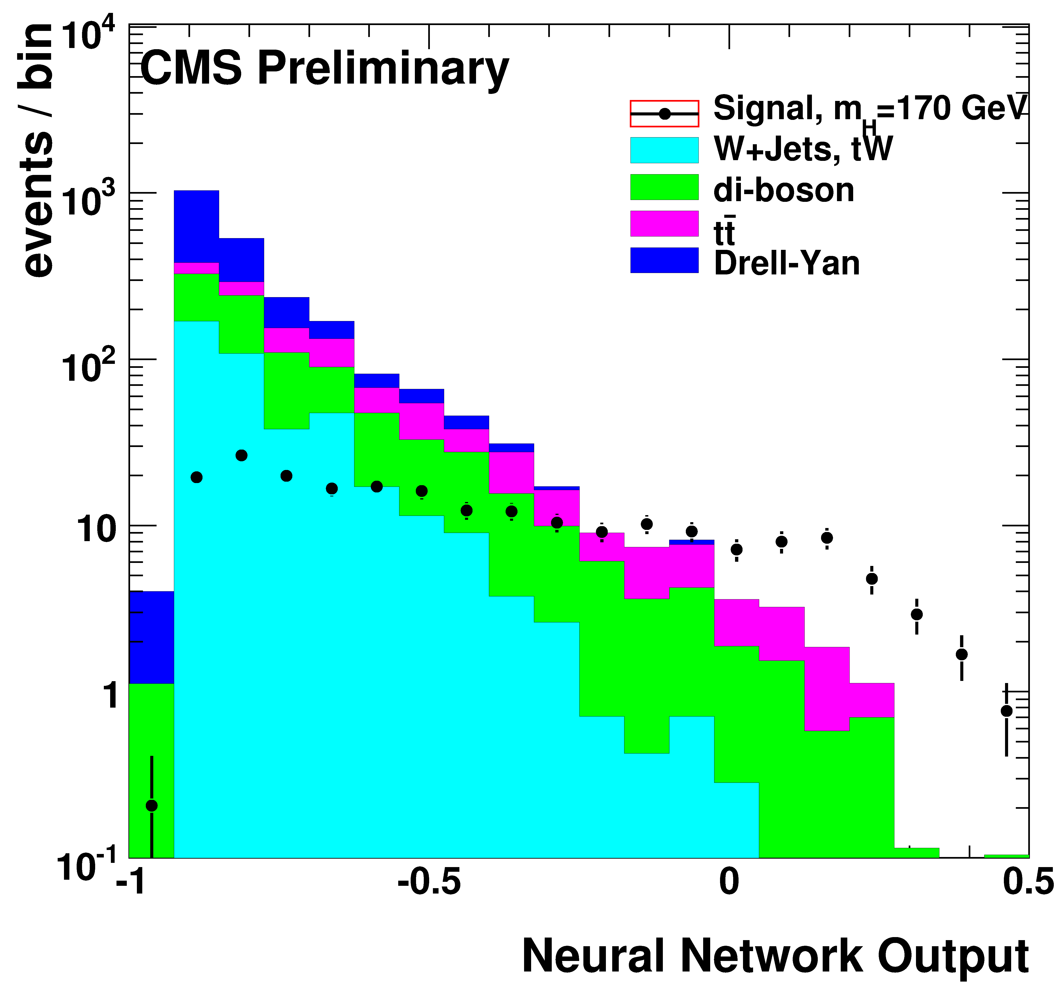
H→WW Event Selection
Large cross section, but no mass peak
Kinematics
  2 energetic , large MET, no jets
Spin correlation
  opposite helicity going same way → Δφ small
Use Multivariate technique to maximize reach
  Neural net, templated likelihood ratio

Slide 23
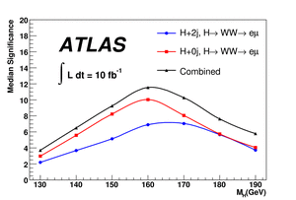
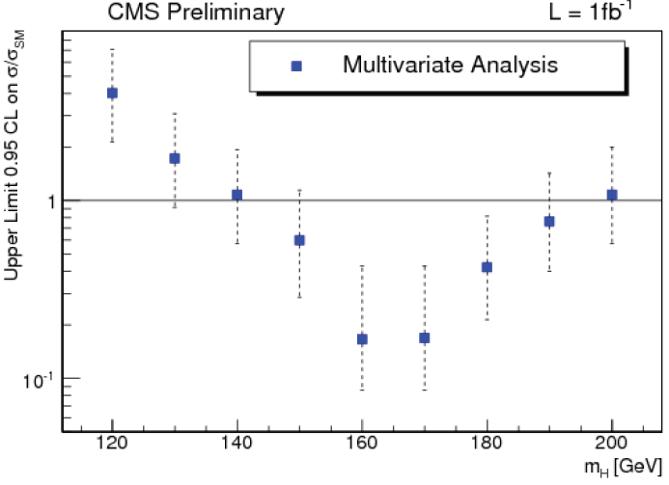
H→WW Prospects, 14 TeV
14 TeV with 10, 1 fb⁻¹

Slide 24
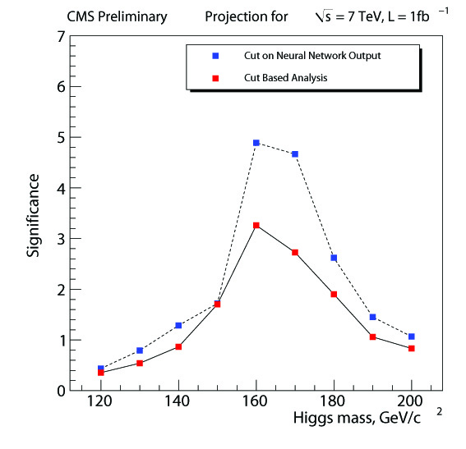
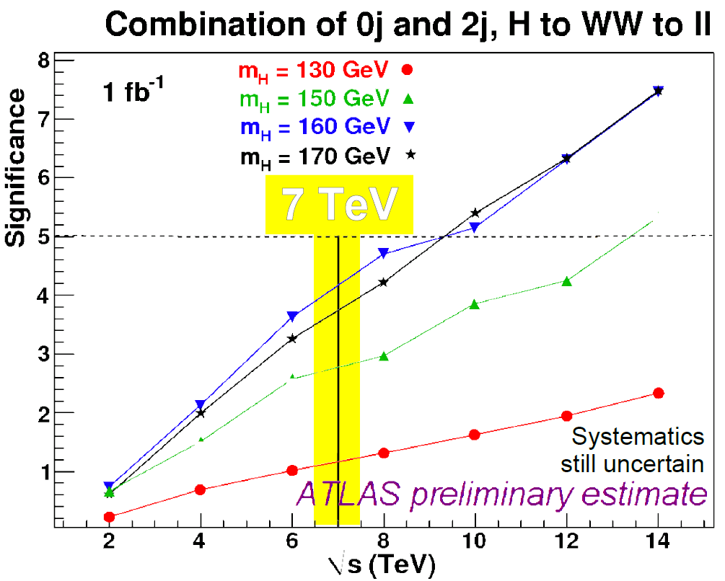
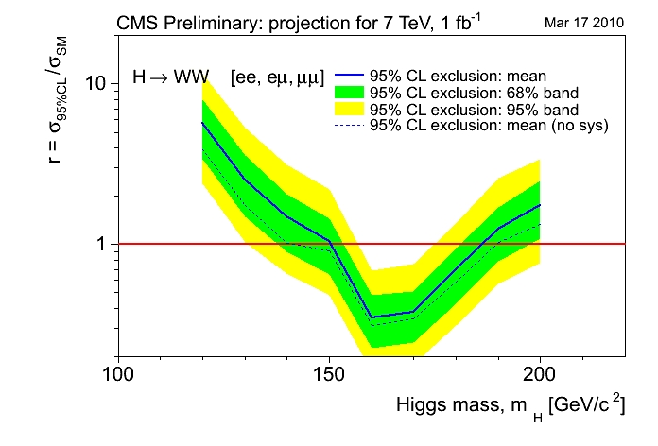
H→WW Prospects, rescaled to 7 TeV

Slide 25
Higgs → ZZ→⁺⁻'⁺'⁻

Slide 26

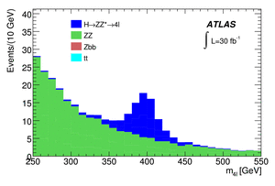
Higgs → ZZ→⁺⁻'⁺'⁻
Small BR, but Mass peak
Huge Background:
  QCD fakes ~ × 10⁷
  ~ × 1000
  ZZ→⁺⁻'⁺'⁻ ~ × 200
4 High p_{T} isolated leptons, min/max m_{+-},m_{'+'-},m_{4}
No missing energy
No jets (except VBF jets)
No displaced vertices
Higgs width degrades sensitivity at high m_{H}

Slide 27
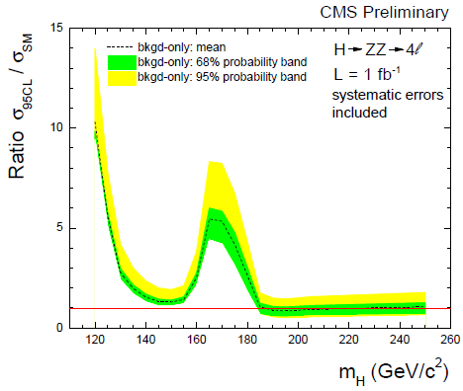
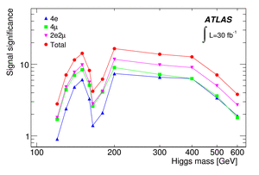
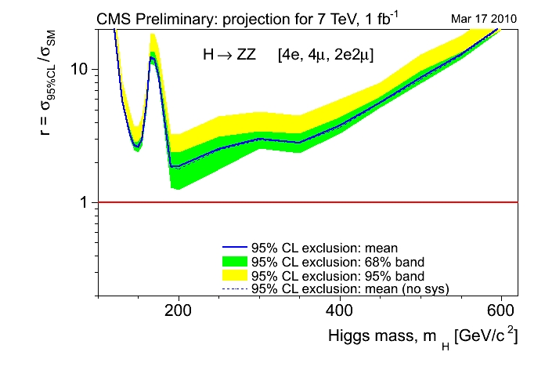
H→ZZ Prospects
14 TeV
7 TeV

Slide 28
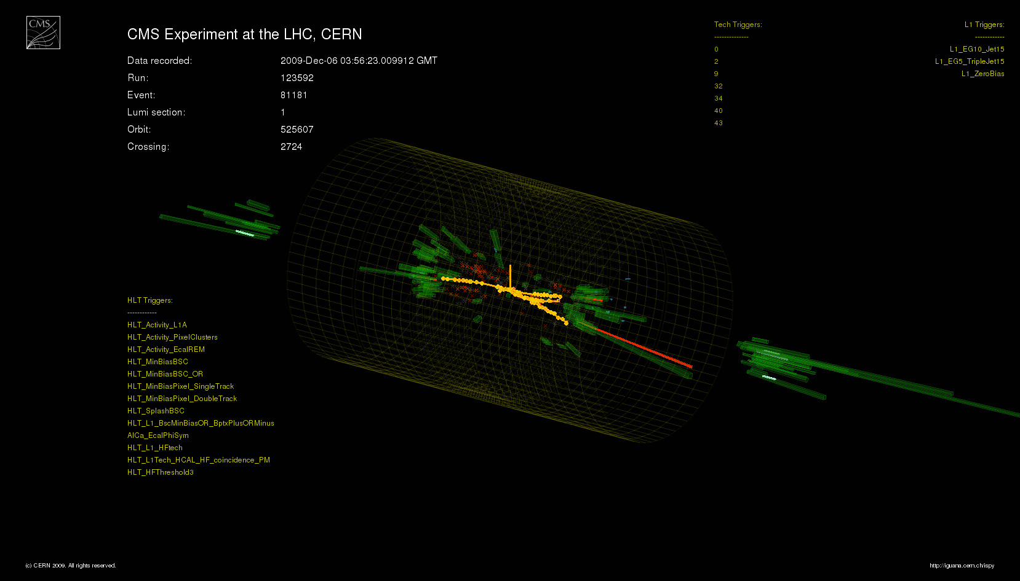
So, what’s new? (again, CMS bias)

Slide 29
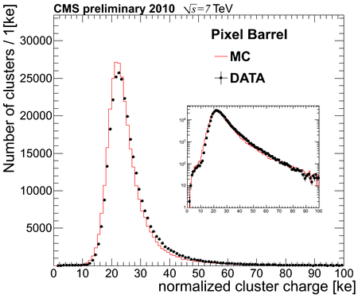
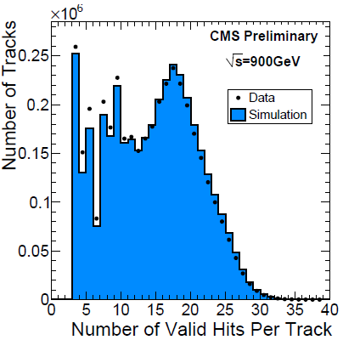
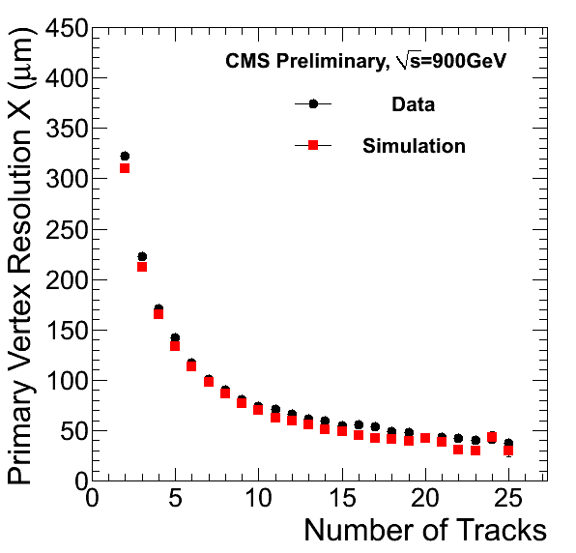
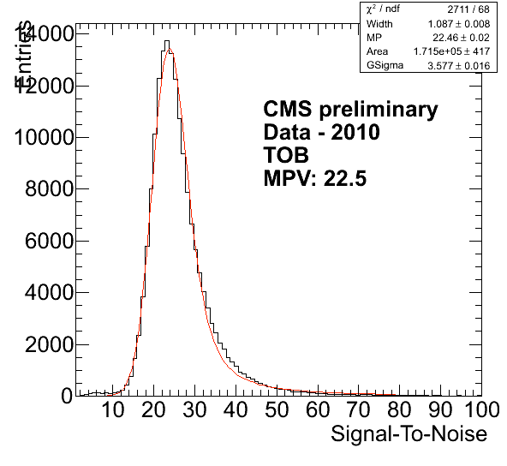
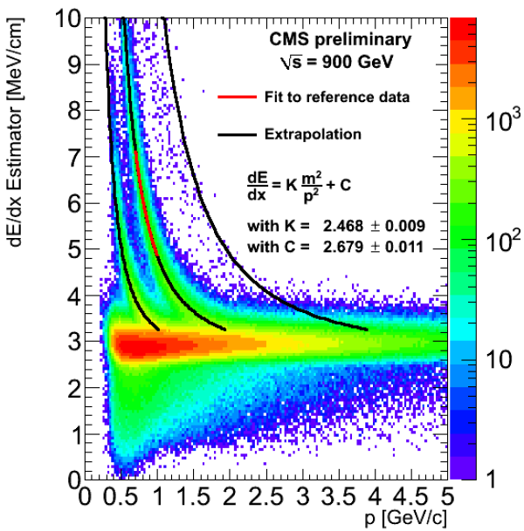
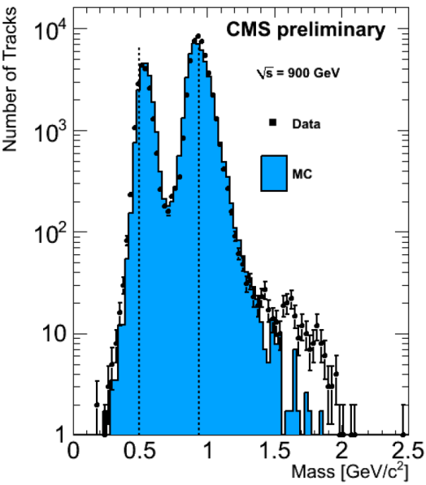
Tracking, Primary Vertices, dE/dx
Tracker Performance excellent, well modeled

Slide 30
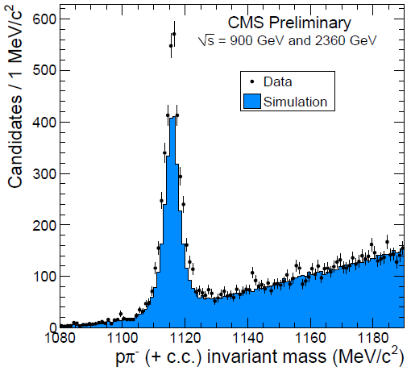
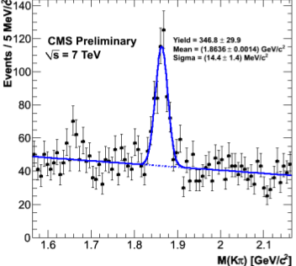
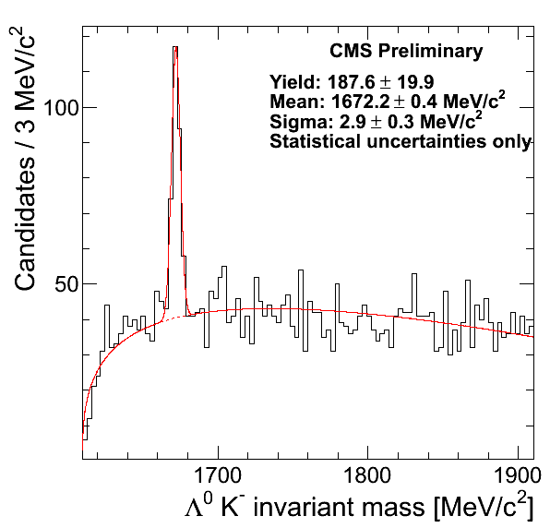

Spectroscopy: K,Λ,φ,Ξ,Ω,D⁰,D⁺,D*…

Slide 31



Starting to look at B tagging
Basic building blocks look ok
Primary Vertex
CMS experiment at LHC, CERN
Run 124022 / Event 13598392
2009-12-12 00:26:16 CEST
Four Tracks Secondary Vertex
Secondary Vertex (2σ ellipse)
with 4 attached tracks
All other tracks
Pt > 500 MeV

Slide 32




ECAL: Photons and Electrons

Slide 33


Jets and MET
Calorimetry only, Cal+Tracks, Particle flow
MET – still have some noise to address in the tails

Slide 34

Muons
Muons via Onia decays
  Some things will require a bit more time…

Slide 35



And the first EW bosons…
In ~ 1 nb⁻¹
  Expect 8 W events, found 3 W→μν, W→eν
  Expect ~ 0.8 Z events, found 1 Z→ee

Slide 36
The message
High Mass channels are the best avenue for Higgs discovery/exclusion in the near term
Both ATLAS and CMS have studied these channels to death in simulation
  Considerable attention paid to methods which reduce dependence on simulation and theory
  Not done yet! Will reoptimize for 7 TeV
Data! Have the ability to scrutinize understanding of the appartus, tune/correct, improve
  So far, things look surprisingly good
Data! The hunt has just begun…

Slide 37
Various backup things

Slide 38

Top with 10 pb⁻¹!
ee
μμ
Validates Zs/Ws
  Leptons, Missing E, plus 2 or more jets
Control sample for b tagging-displaced vertices
Major background for other studies
eμ
S/N ~ 25
All
S/N ~ 7

Slide 39




Multibosons WW,WZ with 100 pb⁻¹
After one boson, two
  σ(WW→νν) ~ 8 pb
    2, E_{T}, No Jets, Z veto
  45.6 signal, 27.7 bkgd
  σ(WZ→ν) ~ 30 pb
    3, E_{T}, M^{Z}, M^{W}_{T}
  12.6 signal, 2.1 bkgd
Important litmus test for Higgs

Slide 40


H → WW→ν'ν' with 200 pb⁻¹@10TeV
Sensitivity: 130 ≤ m_{H} ≤ 180 GeV
  Huge Background:
    W+(jets = lepton) ~ × 20000
    Drell Yan, ~ × 1000
    WW,Wt,WZ, ZZ ~ few × 10
  High p_{T} isolated , min/max m
  Substantial missing energy
  No jets (VBF: forward jets)
  Small lepton opening angle
Lose ~ factor 3 from lower E, ☹
…but continuous improvement
  Updated cross sections
  Better reconstruction, selection

